Slide 1
Principles of Virtualization
Unit-II Deploying And Managing An Enterprise Desktop And Presentation Virtualization Environment

Slide 2
Principles of Virtualization
Deploying And Managing An Enterprise Desktop
Why Should You Enable Virtualization?
Virtualization can increase scalability while reducing costs. Some of the benefits that enabling virtualization can bring to an organization are:
Cost Savings – When you enable virtualization, a single physical server is replaced by multiple virtual machines thereby reducing idle compute time and promoting optimum utilization of resources. Personnel time to manage can be alleviated through improved server utilization. By enabling virtualization, organizations facing resource crunch can do away with multiple servers.

Slide 3
Principles of Virtualization
Deploying And Managing An Enterprise Desktop
Why Should You Enable Virtualization?
Downtime Reduction and Flexibility during Disaster Recovery – When a physical server is affected, replacement or repair is often time-consuming. With virtualization, the virtual machine can be cloned or replicated, significantly speeding up the recovery process and enhancing business continuity.

Slide 4
Principles of Virtualization
Deploying And Managing An Enterprise Desktop
Why Should You Enable Virtualization?
Improved Productivity and Efficiency – Given the nature of the virtual environment, virtual machines are easier to install, maintain and update. Hardware maintenance and monitoring efforts can be reduced drastically since the same updates are not required on each server separately. Thus, improving utilizing the IT team effectively.

Slide 5
Principles of Virtualization
Deploying And Managing An Enterprise Desktop
Why Should You Enable Virtualization?
Development and Testing – Simulation of virtual machines helps the developer to run tests without altering the production environment. Software updates can be rolled out faster since the environment offers agility for development & testing.

Slide 6
Principles of Virtualization
Deploying And Managing An Enterprise Desktop
Why Should You Enable Virtualization?
Enhanced Security – Since virtual servers are isolated, security is more adaptive in such an environment protecting the virtual machines from malware and vicious attacks as they move from one host to another.

Slide 7
Principles of Virtualization
Deploying And Managing An Enterprise Desktop
System Requirements:
Hardware Virtualization System Requirements
Windows 10 Pro or Enterprise
64-bit processor with Second Level Address Translation (SLAT)
4GB system RAM (minimum)
BIOS-level Hardware Virtualization support.

Slide 8
Principles of Virtualization
Deploying And Managing An Enterprise Desktop
Configure the BIOS to support hardware virtualization:
To enable Virtualization in Windows 10/11, ensure that the device supports virtualization by checking the BIOS (Basic Input Output System) or UEFI (Unified Extensible Firmware Interface) firmware settings as follows:

Slide 9
Principles of Virtualization
Deploying And Managing An Enterprise Desktop
Configure the BIOS to support hardware virtualization:
Method 1:
Through Command Prompt
Run command prompt
Enter the command systeminfo.exe
The command will gather system information and display the result
Check Hyper -V Requirements
If Virtualization Enabled in Firmware shows Yes, Windows Sandbox can be used

Slide 10
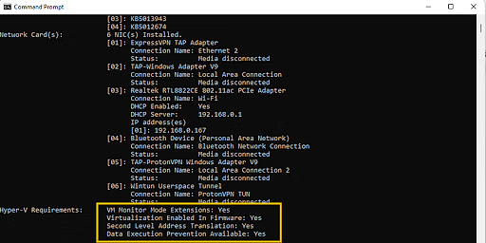
Principles of Virtualization
Deploying And Managing An Enterprise Desktop
Configure the BIOS to support hardware virtualization:
Method 1:

Slide 11
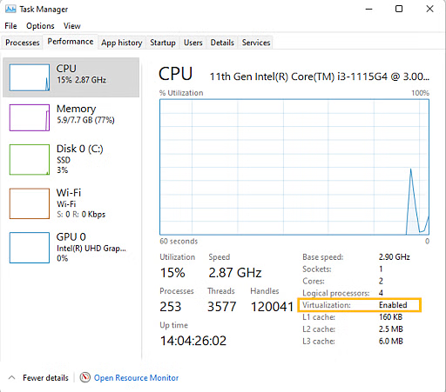
Principles of Virtualization
Deploying And Managing An Enterprise Desktop
Configure the BIOS to support hardware virtualization:
Method 2:
Check the Performance
Tab of the Task Manager

Slide 12
Principles of Virtualization
Deploying And Managing An Enterprise Desktop
Configure the BIOS to support hardware virtualization:
If Virtualization is Disabled, follow these steps to enable it in BIOS or UEFI settings.
How to Enable Virtualization in BIOS?
Reboot the computer
While the system is restarting from a black screen, enter BIOS by pressing the hotkey. The hotkeys differ depending on the brand of the computer used. Usually F1, F2, F3, F10, Esc or Delete keys are the hotkeys to enter BIOS
Navigate to Advanced Tab and press Enter to continue
Select Virtualization and Enable
Save changes and reboot the computer
BIOS can also be accessed through Windows in Settings.

Slide 13
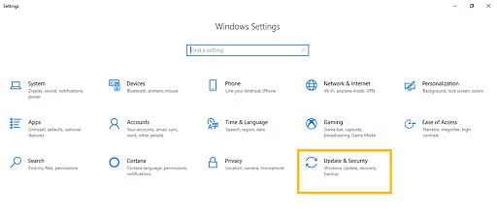
Principles of Virtualization
Deploying And Managing An Enterprise Desktop
Configure the BIOS to support hardware virtualization:
How to Enable Virtualization Windows 10?
Go to Windows Settings
Click on Update and Security

Slide 14
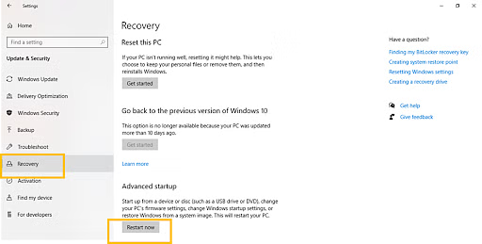
Principles of Virtualization
Deploying And Managing An Enterprise Desktop
Configure the BIOS to support hardware virtualization:
How to Enable Virtualization Windows 10?
3. Click on Restart Now from the Recovery Tab to enter Windows Recovery Environment

Slide 15
Principles of Virtualization
Deploying And Managing An Enterprise Desktop
Configure the BIOS to support hardware virtualization:
How to Enable Virtualization Windows 10?
4.Click Troubleshoot > Advanced > UEFI Firmware Settings.
5. To continue, click Restart
6. BIOS Settings will be displayed. Select Virtualization and enable it

Slide 16
Principles of Virtualization
Deploying And Managing An Enterprise Desktop
How to Enable Virtualization without BIOS?
To enable Virtualization without opening BIOS, follow these steps:
Navigate to the Security tab and press Enter on CPU Setup
Select Intel(R) Virtualization Technology and press Enter
Choose Enable and press Enter
Press F10
Press Enter to select Yes to save the settings and Boot into Windows

Slide 17
Principles of Virtualization
Deploying And Managing An Enterprise Desktop
Install and configure Windows Virtual PC:
What you need: 1) A computer with a processor that supports Virtualization. 2) At least 8-20 GB of disk space(depends on what OS you are installing) and 1 GB of RAM. 3) Installation Media: You must have the CD/DVD or the .iso file. 4) If you are creating a VM that runs Windows you will need the Product Key. 5) An internet connection or the VirtualBox installation file.

Slide 18
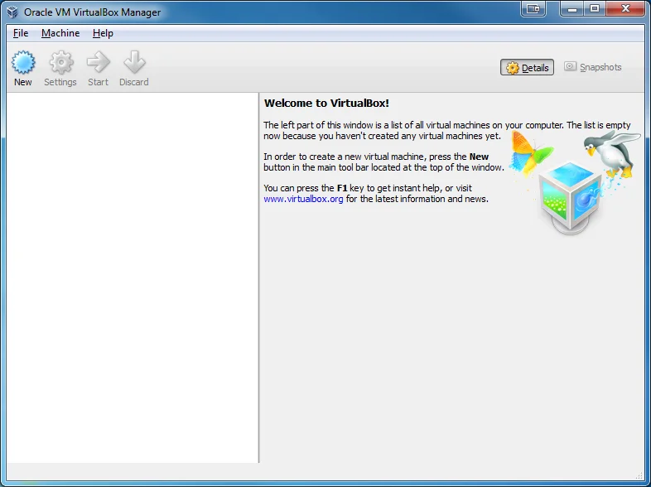
Principles of Virtualization
Deploying And Managing An Enterprise Desktop
Install and configure Windows Virtual PC:
Step 1: Download and Install VirtualBox
Download VirtualBox from https://www.virtualbox.org/wiki/Downloads. Select the version for your Operating System. Install VirtualBox. Keep all of the default settings. You will be prompted to
install several Oracle components.
Install all of them.

Slide 19
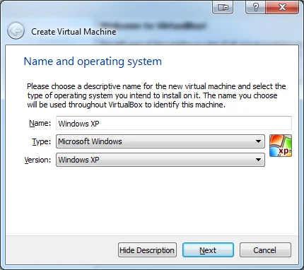
Principles of Virtualization
Deploying And Managing An Enterprise Desktop
Install and configure Windows Virtual PC:
Step 2: Create a Virtual Machine
Start VirtualBox and Click on 'New' in the menu. Enter the Name of your VM.
This is how you will identify
it in VirtualBox so name
it something meaningful to you. Select Type and Version.
This depends on what
OS you are installing.

Slide 20
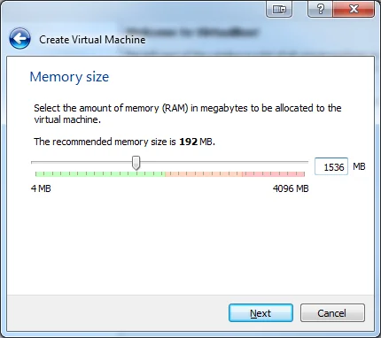
Principles of Virtualization
Deploying And Managing An Enterprise Desktop
Install and configure Windows Virtual PC:
Step 3: Allocate Memory
This depends on how much
memory you have on your
host computer. Never allocate
more than half of your available RAM. If you are creating a Windows VM
I recommend at least (1-2 GB) If you are creating a Linux VM
I recommend at least (512 MB)

Slide 21
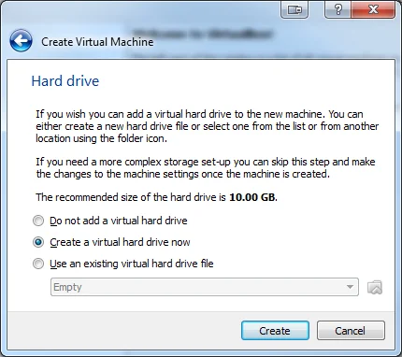
Principles of Virtualization
Deploying And Managing An Enterprise Desktop
Install and configure Windows Virtual PC:
Step 4: Setup the Hard Drive
If you already have an existing
VM that you want to add
select "Use an existing Virtual
hard drive file." Otherwise select "Create a
virtual hard drive now."

Slide 22
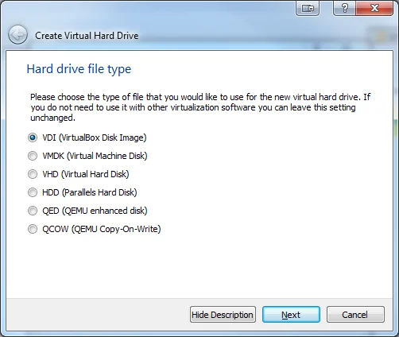
Principles of Virtualization
Deploying And Managing An Enterprise Desktop
Install and configure Windows Virtual PC:
Step 5: Select Hard Drive File Type
Select 'VDI.' This is usually the best option. The VM will be stored in a
single file on your computer
with the .vdi extension.

Slide 23
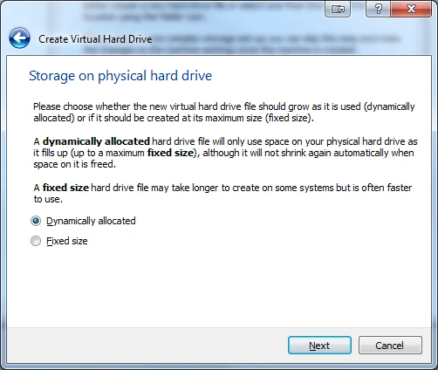
Principles of Virtualization
Deploying And Managing An Enterprise Desktop
Install and configure Windows Virtual PC:
Step 6: Select Storage on Physical Hard Drive
I recommend you choose
"Dynamically allocated."
This will save space on
your computer.

Slide 24
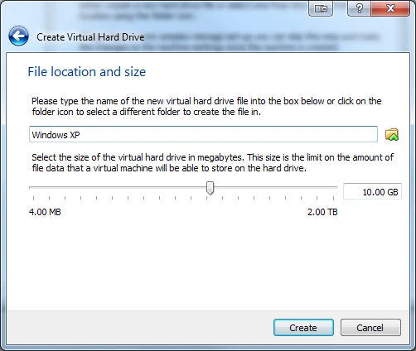
Principles of Virtualization
Deploying And Managing An Enterprise Desktop
Install and configure Windows Virtual PC:
Step 7: Setup File Location and Size
By default, Virtualbox selects
the minimum size you
should choose. Depending on what you
want to do with the VM
you may want to select
a bigger size.

Slide 25
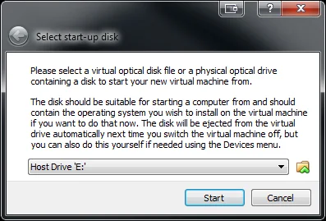
Principles of Virtualization
Deploying And Managing An Enterprise Desktop
Install and configure Windows Virtual PC:
Step 8: Install the Operating System
Double click on your newly created VM
(It will be on the left hand
side and will have the name
you gave it in Step 2). Browse to your installation
media or .iso file. Finish installation. The actual installation process
will depend on which OS you are installing.

Slide 26
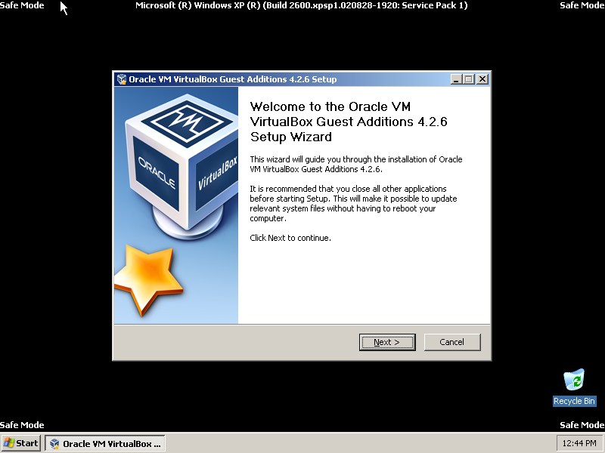
Principles of Virtualization
Deploying And Managing An Enterprise Desktop
Install and configure Windows Virtual PC:
Step 9: Install Guest Additions
Guest additions add more
functionality to your VM,
including the option to
make the VM fullscreen. Boot in Safe Mode. Instructions for Windows XP When you have booted in Safe Mode,
click Devices --> Install Guest Additions Follow the Prompts and Install. Shutdown the VM.

Slide 27
Principles of Virtualization
Deploying And Managing An Enterprise Desktop
Install and configure Windows Virtual PC:
Step 9: Install Guest Additions
Guest additions add more
functionality to your VM,
including the option to
make the VM fullscreen. Boot in Safe Mode. Instructions for Windows XP When you have booted in Safe Mode,
click Devices --> Install Guest Additions Follow the Prompts and Install. Shutdown the VM.

Slide 28
Principles of Virtualization
Deploying And Managing An Enterprise Desktop
Creating and Managing Virtual Hard Disks:
Create a Virtual Hard Disk
You might require more disk space in a virtual machine. For example, if you want to install a large application or work with a large number of files. You can increase the size of the virtual disk already associated with your virtual machine, or you can add a new virtual disk. You can create a virtual hard disk to add to a virtual machine.

Slide 29
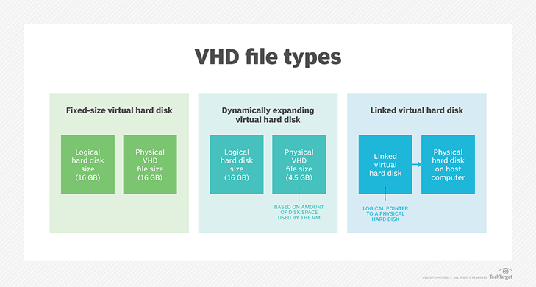
Principles of Virtualization
Deploying And Managing An Enterprise Desktop
Creating and Managing Virtual Hard Disks:
Types of VHD

Slide 30
Principles of Virtualization
Deploying And Managing An Enterprise Desktop
Creating and Managing Virtual Hard Disks:
Create a Virtual Hard Disk
Prerequisites
Shut down or power off the virtual machine. You cannot change the setting while the virtual machine is powered on or suspended.

Slide 31
Principles of Virtualization
Deploying And Managing An Enterprise Desktop
Creating and Managing Virtual Hard Disks:
Create a Virtual Hard Disk
Procedure
Select Window > Virtual Machine Library.
Select a virtual machine in the Virtual Machine Library window and click Settings.
Click Add Device.
Click New Hard Disk.
Click Add.A new hard disk appears. The new hard disk is selected and a default filename appears in the File name pop-up menu.
(Optional) Change the filename for the new virtual hard disk.
Select the filename in the pop-up menu and select Save As.
Type the filename for the hard disk in the Save as field and click Save.
Fusion creates the virtual disk file with this name and stores it in the App bundle directory.
7. Use the Disk size slider to set the maximum size for the hard disk.The maximum size for any hard disk is 8 TB.

Slide 32
Principles of Virtualization
Deploying And Managing An Enterprise Desktop
Creating and Managing Virtual Hard Disks:
Create a Virtual Hard Disk
Procedure
8. (Optional) Under Advanced options, set the Bus type for the hard disk to IDE, SCSI, SATA, or NVMe.
Changing this setting is recommended only for advanced users. Fusion selects the bus type that is most appropriate for the virtual machine guest operating system.
9. Set your disk space configuration, depending on the constraints of the file system

Slide 33
Principles of Virtualization
Deploying And Managing An Enterprise Desktop
Creating and Managing Virtual Hard Disks:
Create a Virtual Hard Disk
Procedure
9. Set your disk space configuration, depending on the constraints of the file system
Option | Description
Option | Description
Click Apply. | For Windows guests, the partition is automatically resized when the hard disk is resized.
Click Apply while pressing the Option key. | The hard disk is resized but the partition is not. To manually resize the partition of the guest, see Resize a Windows Partition with the Disk Management Tool.

Slide 34
Principles of Virtualization
Deploying And Managing An Enterprise Desktop
Creating and Managing Virtual Hard Disks:
Create a Virtual Hard Disk
Procedure
10. Click Apply.The hard disk is created. View the new hard disk in Settings > Removable Devices of the virtual machine.

Slide 35
Principles of Virtualization
Deploying And Managing An Enterprise Desktop
Creating and Managing Virtual Hard Disks:
Resize a Hard Disk
You can increase the usable space in a virtual hard disk. You cannot reduce the size of a hard disk. You cannot make a blank hard disk smaller after it has been formatted.
Prerequisites
Having manual or AutoProtect snapshots in your virtual machine prevents you from making changes to a virtual hard disk. You must delete the snapshots before you can make a change.
Shut down or power off the virtual machine. You cannot change the setting while the virtual machine is powered on or suspended.

Slide 36
Principles of Virtualization
Deploying And Managing An Enterprise Desktop
Creating and Managing Virtual Hard Disks:
Resize a Hard Disk
Procedure
Select Window > Virtual Machine Library.
Select a virtual machine in the Virtual Machine Library window and click Settings.
In the Settings window, click the hard disk you want to resize.
Use the Disk size slider to set the new size.The maximum disk size for any hard disk is 8TB.
(Optional) Under Advanced options, set the Bus type for the hard disk to IDE, SCSI, SATA, or NVMe.

Slide 37
Principles of Virtualization
Deploying And Managing An Enterprise Desktop
Creating and Managing Virtual Hard Disks:
Resize a Hard Disk
6. Set your disk space configuration, depending on the constraints of the file system.
Option | Description
Option | Description
Click Apply. | For Windows guests, the partition is automatically resized when the hard disk is resized.
Click Apply while pressing the Option key. | The hard disk is resized but the partition is not. To manually resize the partition of the guest, see Resize a Windows Partition with the Disk Management Tool.

Slide 38
Principles of Virtualization
Deploying And Managing An Enterprise Desktop
Creating and Managing Virtual Hard Disks:
Resize a Hard Disk
7. Apply the changes and choose automatic or manual partition resize for Windows guests
Option | Description
Click Apply. | For Windows guests, the partition is automatically resized when the hard disk is resized.
Click Apply while pressing the Option key. | The hard disk is resized but the partition is not. To manually resize the partition of the guest, see Resize a Windows Partition with the Disk Management Tool.

Slide 39
Principles of Virtualization
Deploying And Managing An Enterprise Desktop
Creating and Managing Virtual Hard Disks:
Resize a Windows Partition with the Disk Management Tool
When you enlarge your virtual hard disk, you must also enlarge your guest operating system's partition to take advantage of the additional space.
Fusion resizes the guest operating system's partition when you resize the virtual hard disk. If you held down the Option key when you clicked Apply to resize the disk, you can manually resize the Windows partition. For Windows Vista and Windows 7 or later, you can use the operating system's Disk Management tool to resize a partition.

Slide 40
Principles of Virtualization
Deploying And Managing An Enterprise Desktop
Creating and Managing Virtual Hard Disks:
Resize a Windows Partition with the Disk Management Tool
Prerequisites
Verify that your virtual hard disk is big enough to accept the increase in partition size. See Resize a Hard Disk.
Procedure
Right-click Computer and select Manage.
Double-click Storage.
Double-click Disk Management.
In the list, right-click the partition to expand and select Extend Volume.
Follow the prompts to resize the partition and click Finish. The partition item in the Disk Management pane displays its new size.
Close the Computer Management window

Slide 41
Principles of Virtualization
Deploying And Managing An Enterprise Desktop
Creating and Managing Virtual Hard Disks:
Clean up a Virtual Machine
You can perform a manual or automated cleanup of certain virtual machines to free up space on your Mac. The cleanup compacts and defragments the virtual machine.
When you delete files from your virtual machine, Fusion does not return the space to your Mac. Cleaning up the virtual machine performs the following operations.Compacts the virtual machine and returns freed space to your Mac.
Note:Only Windows virtual machines return freed space to your Mac.
Defragments the virtual machine.
Consolidates any unconsolidated snapshot files left on the virtual machine. Unconsolidated snapshot files can be left on the virtual machine when manually deleting a snapshot fails.
Disk cleanup is not supported in the following situations.The virtual hard disk uses a FAT32, FAT, or exFAT file system.
The virtual hard disk uses a preallocated disk format.

Slide 42
Principles of Virtualization
Deploying And Managing An Enterprise Desktop
Creating and Managing Virtual Hard Disks:
Clean up a Virtual Machine
Prerequisites
To perform a manual cleanup, shut down or power off the virtual machine. You cannot perform the manual cleanup while the virtual machine is powered on or suspended.
Procedure
Select Window > Virtual Machine Library.
Select a virtual machine in the Virtual Machine Library window and click Settings.
Under System Settings in the Settings window, click General.

Slide 43
Principles of Virtualization
Deploying And Managing An Enterprise Desktop
Creating and Managing Virtual Hard Disks:
Clean up a Virtual Machine
4. Select a cleanup option
Manual | Click Clean Up Virtual Machine. This option is only available when a Windows virtual machine has disk space to reclaim, or when any virtual machine has unconsolidated snapshot files. Fusion displays a progress dialog box as it cleans up the virtual machine.
Automated | Select Clean up disks after shutting down virtual machine. Fusion cleans up the virtual machine every time the virtual machine is shut down.

Slide 44
Principles of Virtualization
Deploying And Managing An Enterprise Desktop
Creating and Managing Virtual Hard Disks:
Add an Existing Virtual Hard Disk
You can add an existing virtual hard disk to a virtual machine. You can copy or move the disk to your virtual machine, or share it between virtual machines.
Procedure
Select Window > Virtual Machine Library.
Select a virtual machine in the Virtual Machine Library window and click Settings.
Click Add Device.
Click Existing Hard Disk.
Click Add Device.
In the Open dialog, navigate to the location of the existing .vmdk hard disk file.

Slide 45
Principles of Virtualization
Deploying And Managing An Enterprise Desktop
Creating and Managing Virtual Hard Disks:
Add an Existing Virtual Hard Disk
7. Select the method for adding the virtual hard disk file
8. Click Open.
9. Click Apply
Option | Description
Make a separate copy of the virtual disk | Default. Copies the virtual hard disk file to this virtual machine’s package. Copying the virtual hard disk ensures that no conflicts exist between this virtual machine and any other virtual machine that might be using the virtual hard disk.
Share this virtual disk with the virtual machine that created it | Virtual hard disk file remains in its original location. This might cause a conflict if it is also being used by that original virtual machine.
Take this disk away from the virtual machine currently using it | Moves the virtual hard disk file to this virtual machine’s package.

Slide 46
Principles of Virtualization
Deploying And Managing An Enterprise Desktop
Creating and Managing Virtual Hard Disks:
Add a VMDK on a Remote Virtual Machine
You can add a virtual hard disk and select a disk image on a virtual machine hosted on a remote server.
Prerequisites
Verify that the following conditions are met:
You have login credentials for the server where the virtual machine is hosted.
The virtual machine is powered off

Slide 47
Principles of Virtualization
Deploying And Managing An Enterprise Desktop
Creating and Managing Virtual Hard Disks:
Remove a Hard Disk
You can remove a virtual hard disk from your virtual machine.
Prerequisites
Shut down or power off the virtual machine. You cannot change the setting while the virtual machine is powered on or suspended.
Procedure
Select Window > Virtual Machine Library.
Select a virtual machine in the Virtual Machine Library window and click Settings.
In the Settings window, click the hard disk to remove from the virtual machine.
Under Advanced options, click Remove Hard Disk.

Slide 48
Principles of Virtualization
Deploying And Managing An Enterprise Desktop
Creating and Managing Virtual Hard Disks:
Remove a Hard Disk
5. In the confirmation window, select the option for removing the hard disk.
Option | Description
Keep File | The virtual hard disk is disconnected from the virtual machine, but the hard disk files remain in the virtual machine package.
Move to Trash | The virtual hard disk files are deleted from the virtual machine package.

Slide 49
Principles of Virtualization
Deploying And Managing An Enterprise Desktop
Creating and Managing Virtual Hard Disks:
Using Virtual DiskManager
Virtual Disk Manager (vmware-vdiskmanager) is a Fusion utility that you can use to create, manage, and modify virtual disk files from the command line or in scripts.
Virtual Disk Manager is included when Fusion is installed. With Virtual Disk Manager, you can enlarge a virtual disk so that its maximum capacity is larger than it was when you created it. This feature is useful if you need more disk space in a given virtual machine, but do not want to add another virtual disk or use ghosting software to transfer the data on a virtual disk to a larger virtual disk.
You can also use Virtual Disk Manager to change how disk space is allocated for a virtual hard disk. You can preallocate all the disk space in advance or configure the disk to grow as more disk space is needed. If you allocate all the disk space but later need to reclaim some hard disk space on the host system, you can convert the preallocated virtual disk into a growable disk. The new virtual disk is still large enough to contain all the data in the original virtual hard disk. You can also change whether the virtual hard disk is stored in a single file or split into 2GB files.
The Virtual Disk Manager file, vmware-vdiskmanager, is located in the Applications/VMware Fusion.app/Contents/Library directory.

Slide 50
Principles of Virtualization
Deploying And Managing An Enterprise Desktop
Prepare and manage remote applications:
Configuring Application Sharing with RemoteApp
Overview of RemoteApp:
RemoteApp is a feature of Remote Desktop Services (RDS) that allows applications running on a remote server to be accessed as if they are running on the user's local device. This is particularly useful in environments where centralized management of applications is needed, such as in enterprises or educational institutions.

Slide 51
Principles of Virtualization
Deploying And Managing An Enterprise Desktop
Prepare and manage remote applications:
Configuring Application Sharing with RemoteApp
Step-by-Step Guide:
Ensure Server Requirements:
Your server should be running Windows Server (e.g., Windows Server 2019 or 2022) with Remote Desktop Services (RDS) installed.
Ensure you have administrative privileges.
Open RemoteApp Manager:
Launch Server Manager from the Start menu.
Navigate to Remote Desktop Services under the Roles section.
Select RemoteApp Manager from the left-hand menu.
Example: Server Manager interface with Remote Desktop Services selected.

Slide 52
Principles of Virtualization
Deploying And Managing An Enterprise Desktop
Prepare and manage remote applications:
Configuring Application Sharing with RemoteApp
Step-by-Step Guide:
1. Ensure Server Requirements:
Your server should be running Windows Server (e.g., Windows Server 2019 or 2022) with Remote Desktop Services (RDS) installed.
Ensure you have administrative privileges.
2. Open RemoteApp Manager:
Launch Server Manager from the Start menu.
Navigate to Remote Desktop Services under the Roles section.
Select RemoteApp Manager from the left-hand menu.
Example: Server Manager interface with Remote Desktop Services selected.

Slide 53
Principles of Virtualization
Deploying And Managing An Enterprise Desktop
Prepare and manage remote applications:
Configuring Application Sharing with RemoteApp
Step-by-Step Guide:
3. Add an Application to RemoteApp:
In RemoteApp Manager, click on Add RemoteApp Programs.
A wizard will guide you through selecting the applications installed on the server that you want to share.
Example: Adding a program to RemoteApp.
4. Configure Program Properties:
After adding applications, you can configure properties like file associations, gateway settings, and certificates.
This configuration ensures that users can access the application seamlessly and securely.
Example: Configuring RemoteApp program properties.

Slide 54
Principles of Virtualization
Deploying And Managing An Enterprise Desktop
Prepare and manage remote applications:
2. Packaging Applications for Deployment
Creating a RemoteApp Package:
1. Generating RDP or MSI Files:
Once the applications are configured, you need to package them into files that users can access.
In RemoteApp Manager, select the application and choose Create .RDP File or Create .MSI Package.
The .RDP file allows users to create a remote desktop connection directly, while the .MSI package can be installed locally.
Example: Creating an RDP or MSI package for deployment

Slide 55
Principles of Virtualization
Deploying And Managing An Enterprise Desktop
Prepare and manage remote applications:
2. Packaging Applications for Deployment
Creating a RemoteApp Package:
2. Distributing the Application Package:
The generated .RDP or .MSI files can be distributed to end users via email, a shared network location, or through group policies.
Users can install or run these files on their local machines, giving them access to the remote application as if it were installed locally.
Example: Distributing the application package to users.

Slide 56
Principles of Virtualization
Deploying And Managing An Enterprise Desktop
Prepare and manage remote applications:
3. Installing and Configuring the RD Session Host Role Service
Installing the RD Session Host Role Service:
Installation via Server Manager:
Open Server Manager and go to Manage > Add Roles and Features.
Select Role-based or feature-based installation and then choose the server from the server pool.
Example: Navigating the Add Roles and Features wizard in Server Manager.

Slide 57
Principles of Virtualization
Deploying And Managing An Enterprise Desktop
Prepare and manage remote applications:
3. Installing and Configuring the RD Session Host Role Service
Installing the RD Session Host Role Service:
2. Select Remote Desktop Services:
In the Roles section, check Remote Desktop Services.
Proceed through the wizard to install the Remote Desktop Session Host role.
Example: Selecting the RD Session Host role in Server Manager.

Slide 58
Principles of Virtualization
Deploying And Managing An Enterprise Desktop
Prepare and manage remote applications:
3. Installing and Configuring the RD Session Host Role Service
Installing the RD Session Host Role Service:
3. Configure Session Host Settings:
After installation, configure the RD Session Host settings, such as session limits, licensing, and security configurations.
Go to Remote Desktop Services > Session Host Configuration.
Here, you can fine-tune the settings for sessions, set up load balancing, and configure security settings like SSL encryption.
Example: Configuring RD Session Host settings..

Slide 59
Principles of Virtualization
Deploying And Managing An Enterprise Desktop
Prepare and manage remote applications:
4. Security and Performance Considerations
Enhancing Security:
Encryption: Ensure that all Remote Desktop Protocol (RDP) connections are secured with SSL/TLS to prevent unauthorized access.
User Access: Use group policies to restrict access to the RD Session Host to authorized users only.

Slide 60
Principles of Virtualization
Deploying And Managing An Enterprise Desktop
Prepare and manage remote applications:
4. Security and Performance Considerations
Optimizing Performance:
Session Limits: Set session time limits to prevent server overloading by inactive users.
Resource Allocation: Adjust CPU and memory allocations for each session to optimize the performance of hosted applications.
Load Balancing: Implement load balancing if you have multiple RD Session Hosts to distribute user sessions evenly.

Slide 61
Principles of Virtualization
Deploying And Managing An Enterprise Desktop
Prepare and manage remote applications:
5. Monitoring and Maintenance
Monitoring Active Sessions:
Use Remote Desktop Services Manager to monitor active sessions, check resource usage, and manage user sessions.
This tool provides real-time insights into which users are connected and the resource load on the server.
Example: Monitoring sessions using Remote Desktop Services Manager.

Slide 62
Principles of Virtualization
Deploying And Managing An Enterprise Desktop
Prepare and manage remote applications:
5. Monitoring and Maintenance
Regular Updates and Maintenance:
Apply Updates: Regularly update the RD Session Host and RemoteApp packages with the latest software updates and security patches.
Backup Configurations: Ensure that your RD Session Host configuration is backed up regularly to prevent data loss.
By following these detailed steps, you’ll have a well-configured and managed remote application environment, providing users with secure, efficient, and seamless access to necessary applications.

Slide 63
Keep Learning
Thank You!

